Slide 1
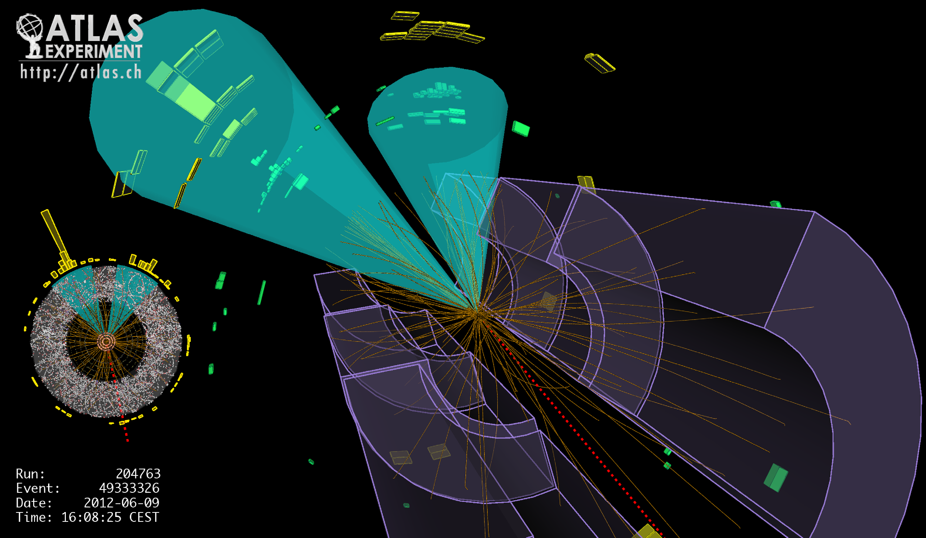
Lecture #3
Prof. Dr. Florencia Canelli
Universität Zürich
Elementary particle physics - PHY451
HS2016
Credits: CERN Summer lectures (di Lella), Hadron collider lectures

Slide 2
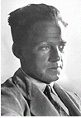
The uncertainty principle
CLASSICAL MECHANICS
Position and momentum of a particle can be measured
independently and simultaneously with arbitrary precision
W. Heisenberg
QUANTUM MECHANICS
Measurement perturbs the particle state ⇒ position and momentum
measurements are correlated:
(also for y and z components)
Similar correlation for energy and time measurements:
Quantum Mechanics allows a violation of energy conservation
by an amount ΔE for a short time Δt ≈ ħ / ΔE
Numerical example:

Slide 3
Proposing mesons (recap lecture #2)
First prediction of mesons by Yukawa (1934):
Explain how neutrons and protons bind together in nucleus
Introduced a new force, short-ranged which is mediated by massive mesons (mesons= medium weight)
Mesons should be 3-400 times the electron mass
From uncertainty principle with time given by nucleon radius as

Slide 4
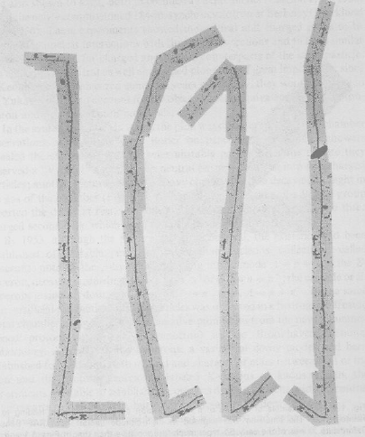
True mesons and the muon (recap lecture #2)
Anderson finds a particle with lifetime was too long, interacting weakly not strongly
Two experiments clarify the situation (Rome, 1946 & Powell et al. in Bristol, 1947):
Used photo emulsion in mountain tops and balloons
There are two new particles: One weakly interacting, the muon, μ, one strongly interacting, the pion, π
Pion decay from Powell
Click here for some history: The pion pioneers - CERN Courier 1997

Slide 5
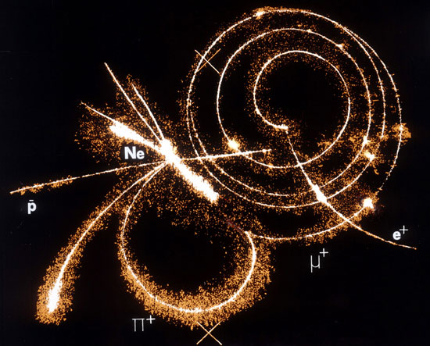
True muon and mesons
Properties of the two new particles:
The pion, π decays quickly => strong interactions
This is the meson postulated by Yukawa
The muon, μ has longer lifetime => weak interactions
in fact a lepton (like electron, 200 times heavier)
Who ordered that ? Rabi

Slide 6
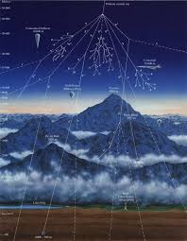

True muon and mesons in cosmic rays
Pions are generated in the atmosphere by nuclear collisions of incoming cosmic protons
Charged pion lifetime 25 ns decay to muons and neutrino
Neutral pion lifetime 10⁻¹⁶ s decays to 2 photons, producing electron-photon cascade (soft)
Muon lifetime 2200 ns, can be energetic enough penetrate atmosphere (2-3 GeV) (hard) or can decay in flight

Slide 7
Particles by the end of 1940’s
By 1947 Yukawa’s particle was found and the only unanticipated particle was the muon’
Few cosmic-ray laboratories after the war:
Bristol – led by Powell
Manchester – led by Blackett
Ecole Polytechnique - lead by Leprince-Ringuet
Caltech – led by Anderson
Berkeley – led by Brode and Fretter

Slide 8
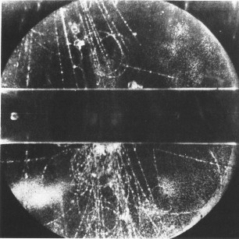
Finding strange particles
G. Rochester and C. Butler published 2 cloud chamber pictures in 1947
Cloud chamber experiment with cosmic rays. Unusual “fork” of a π⁺ and a π⁻
A new cosmic ray particles with mass between π and p, the kaon, K
K, like pions, but strangely long lifetime (decays to pions or a muon+neutrino)
Kaons first called “V” particles
Called “strange” because they behaved differently from others

Slide 9
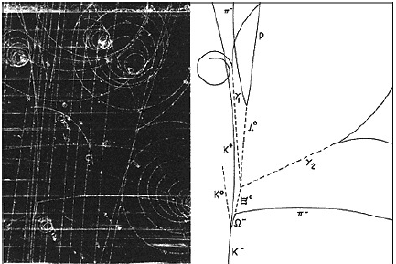
Finding strange particles
V. Hopper and S. Biswas in Melbourne found tracks in emulsions flown in a balloon in 1950
Another “strange” particle was found
Lambda, produced via strong interactions
As the K, they travel measureable distance before decaying
(not the original picture from discovery, this is Omega discovery)
This behavior made them strange

Slide 10
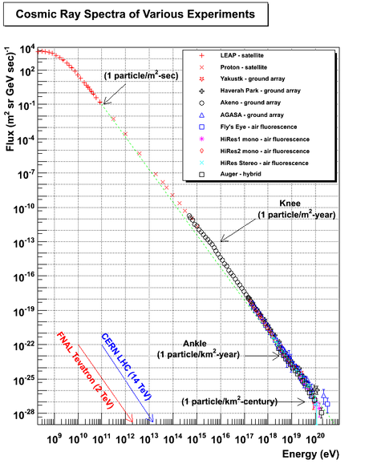
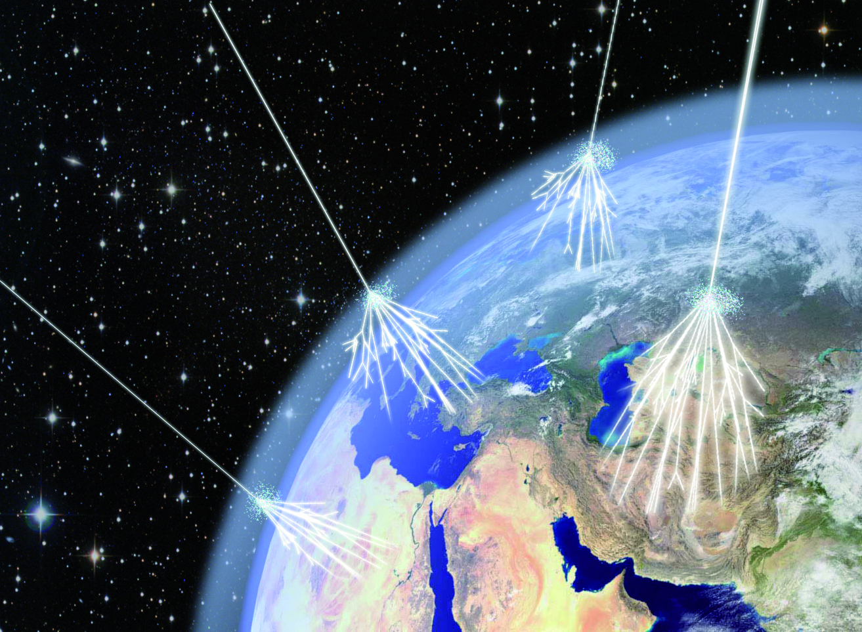
From cosmic rays to particle accelerators
Radioactive sources produce maximum energies of a few million electron volts (MeV)
Studies of cosmic rays in the 30’s extended our knowledge of the SM particles
Cosmic rays can reach energies of ~1,000,000,000 times the LHC energies but the rates are too low to be useful as a study tool
Cosmic rays have huge energies, where and how they are produced is still a big open question

Slide 11
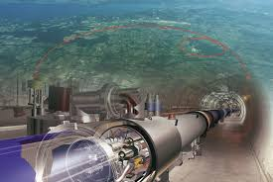
From cosmic rays to particle accelerators
Accelerators allow to regulate the energy of the particles as well as the number of particles, so the rate of particles is higher
Also can control the entire experimental conditions allowing to reproduce results

Slide 12
Accelerator history
1921: “Kaskadengenerator” (Greinacher) (habilitation from Univ. Zurich)
1924-1928: Concept and first prototype of linear accelerator (Ising, Wideröe)
1932: First nuclear reaction induced by cascade particle accelerator, p7Li→2α with 400 keV protons (Cockroft/Walton)
1930: First Van de Graaff accelerator with 1.5 MV
1930-1932: First 1.5 MeV cyclotron (concept: Lawrence)
Upgraded cyclotrons (Synchrocyclotron): 300-700 MeV
1953: First synchrotron at Brookhaven lab - Cosmotron (concept: Oliphant/Veksler/McMillan): 3 GeV
1954: Weak-focusing proton synchrotron at Berkeley lab – Bevatron: 6 GeV
1958: Proton Syncrotron (CERN): 28 GeV
1983: Tevatron (Fermilab): 1000 GeV
1990: HERA (DESY): first and only electron-proton collider
2008: Large Hadron Collider (CERN): up to 7000 GeV

Slide 13
Accelerator history
1921: “Kaskadengenerator” (Greinacher) (habilitation from Univ. Zurich)
1924-1928: Concept and first prototype of linear accelerator (Ising, Wideröe)
1932: First nuclear reaction induced by cascade particle accelerator, p7Li→2α with 400 keV protons (Cockroft/Walton)
1930: First Van de Graaff accelerator with 1.5 MV
1930-1932: First 1.5 MeV cyclotron (concept: Lawrence)
Upgraded cyclotrons (Synchrocyclotron): 300-700 MeV
1953: First synchrotron at Brookhaven lab - Cosmotron (concept: Oliphant/Veksler/McMillan): 3 GeV
1954: Weak-focusing proton synchrotron at Berkeley lab – Bevatron: 6 GeV
1958: Proton Syncrotron (CERN): 28 GeV
1983: Tevatron (Fermilab): 1000 GeV
1990: HERA (DESY): first and only electron-proton collider
2008: Large Hadron Collider (CERN): up to 7000 GeV
We’ll get back to accelerators in a future lecture
For now, lets concentrate on the physics from the

Slide 14
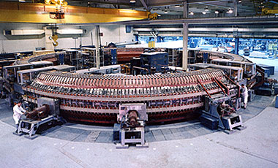
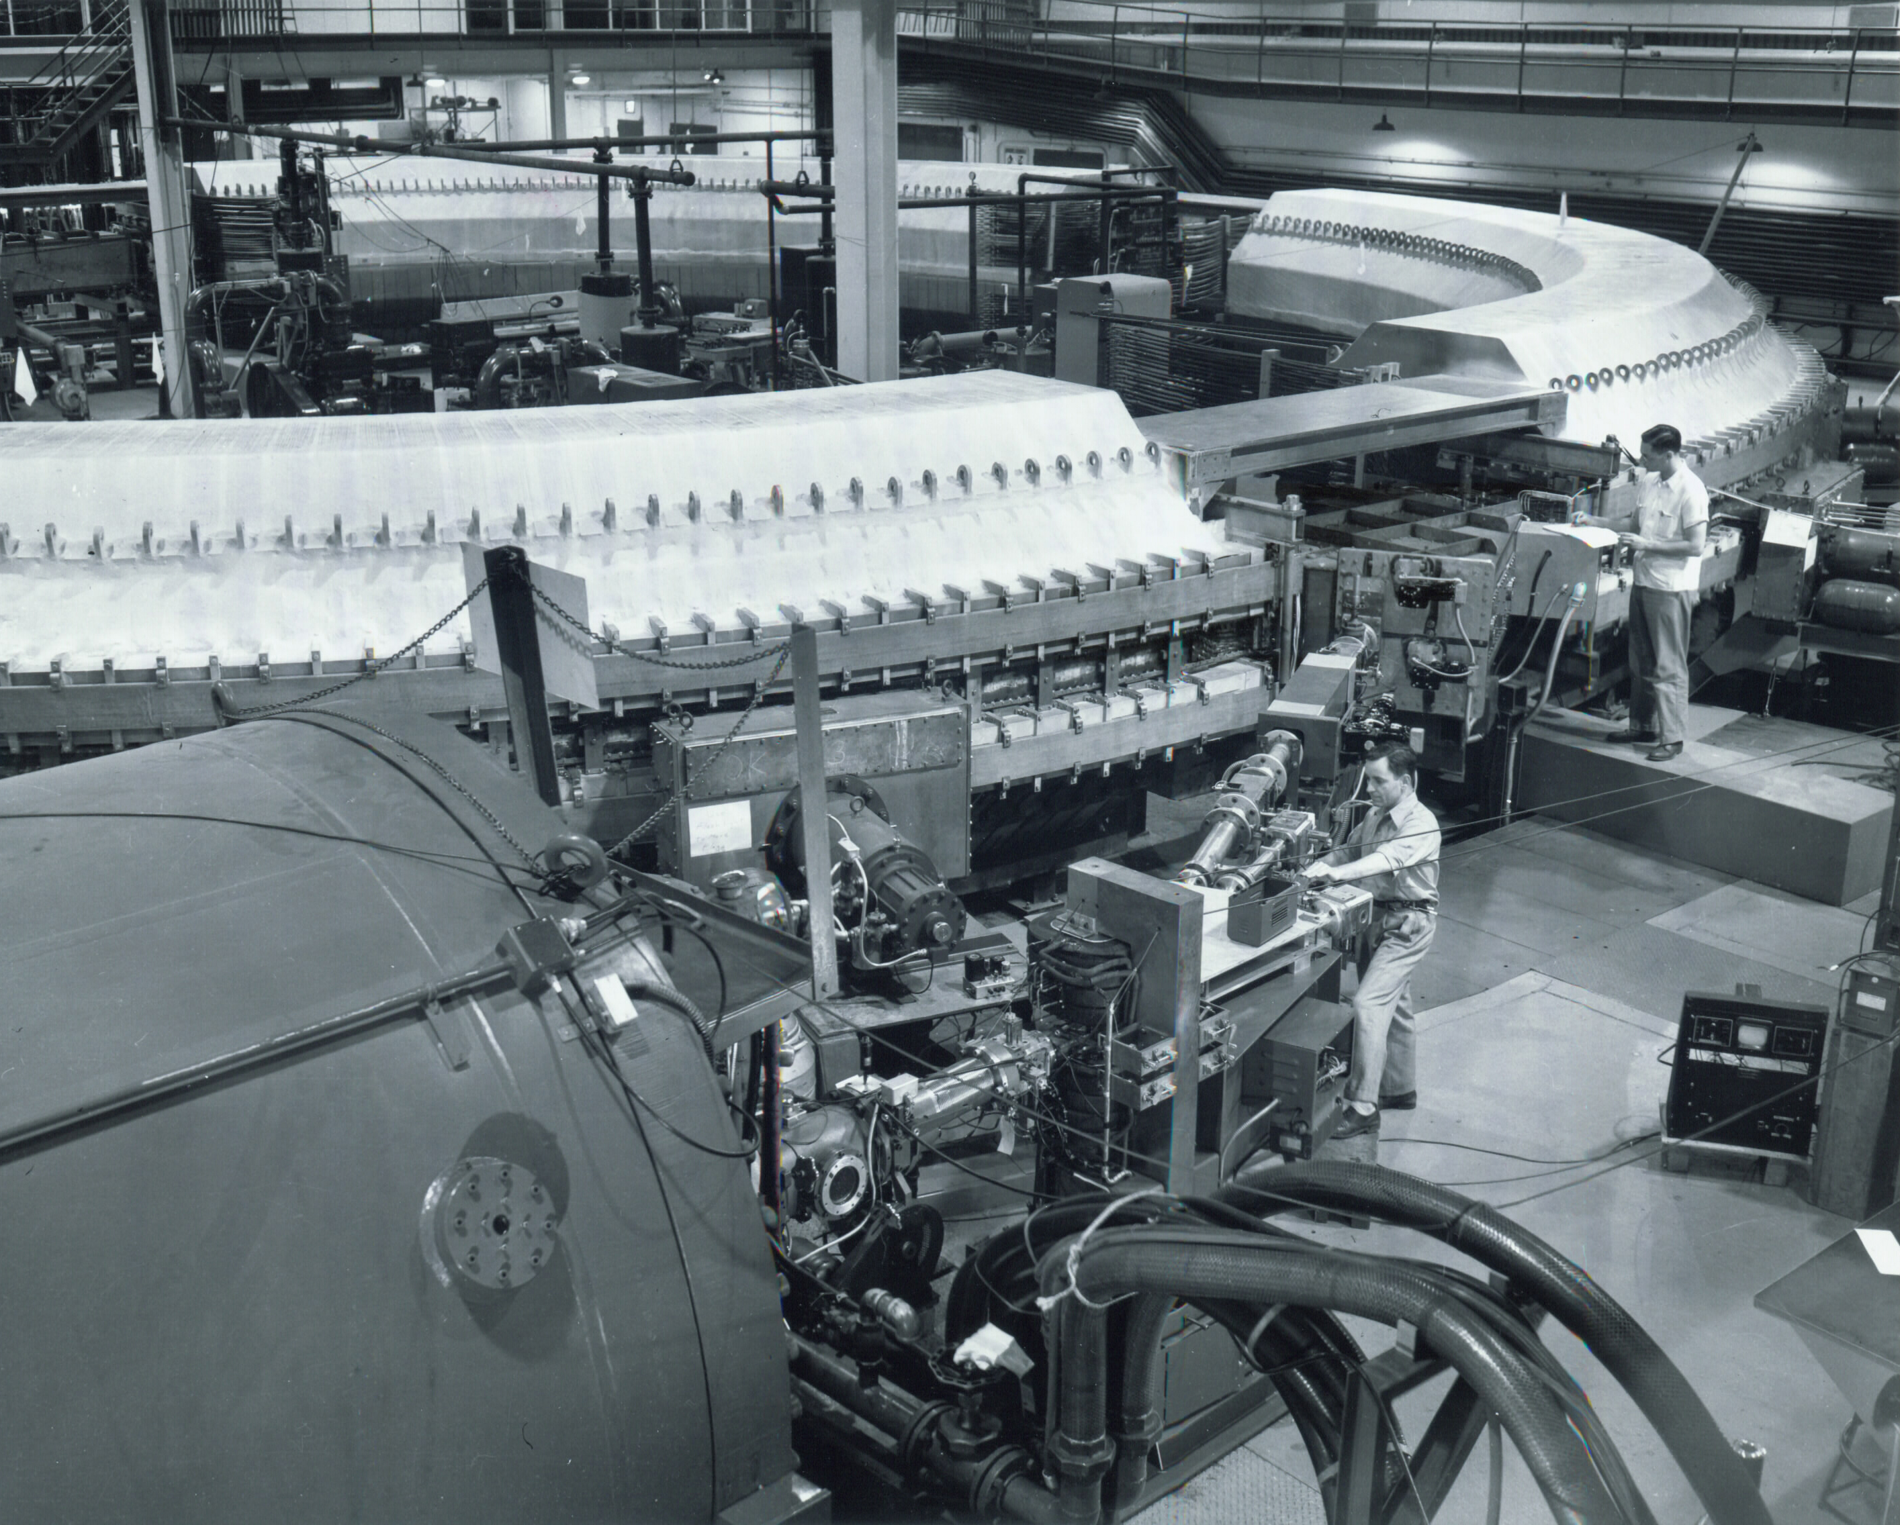
Producing strange particles
Cosmotron in BNL, 1952-1966 GeV
Reached 3.3 GeV
Produced many mesons and allowed the study of strange particles in the laboratory
Strange particles (kaons and lambdas) are copiously produced, but decay slowly => strong interaction in production, weak interaction in decay!
Bubble chamber were used to study of reactions
Click here for an audio tour of the Cosmotron at BNL

Slide 15
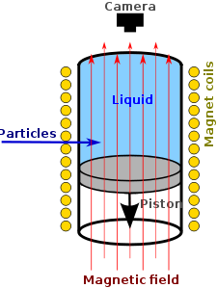
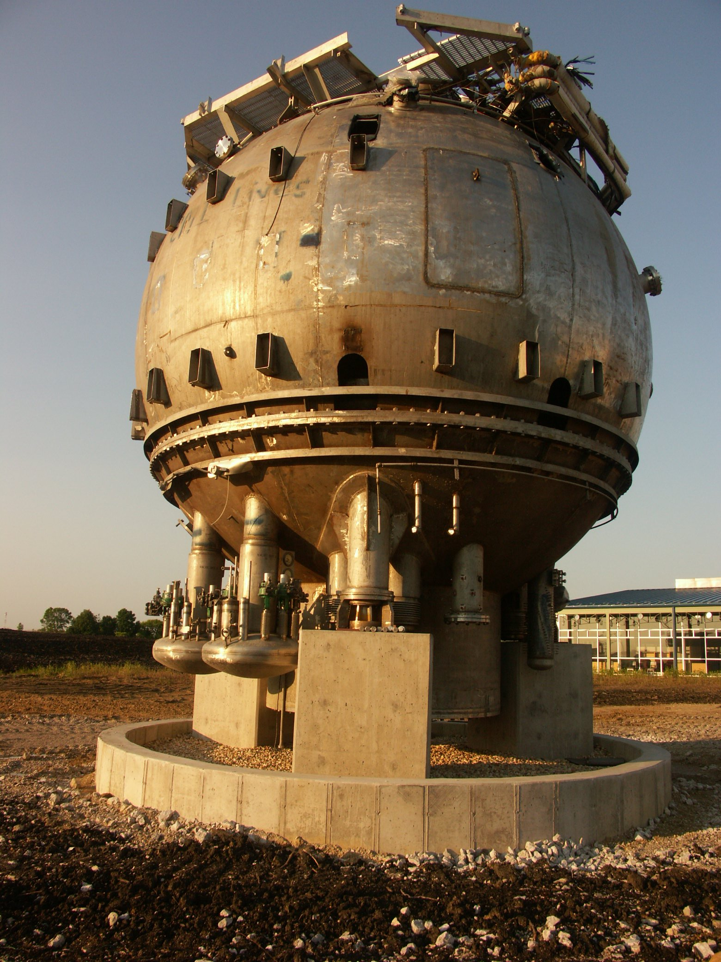
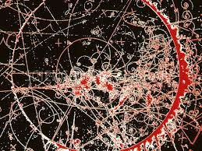
Bubble chamber
Invented by D. Glaser in 1952
Similar to the cloud chamber but uses superheated liquid instead of vapor
Liquid is heated above its boiling point. When a charged particle moves through the chamber, the liquid boils leaving a track of bubbles
The track is photographed
Talk by D. Glaser

Slide 16
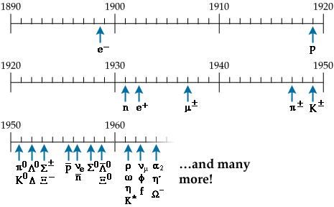
Situation until the 60’s
1940’s to 1960’s : Plenty new particles discovered (mainly in cosmic rays):
e-, p, n, ν, μ⁻, π±, π⁰, Λ⁰, Σ⁺ , Σ⁰ , Ξ,….
1950’s – 1960’s: accelerators, better detectors:
even more new particles are found, many of them extremely short-lived (decay after 10⁻²¹ sec)
Often observed particles actually originate from the decay of resonances of very short-lived particles

Slide 17
Situation in the 60’s
Can nature be so messy?
Are all these particles really intrinsically different?
What are the patterns or symmetries in their nature (charge, mass, flavor) or the way they behave (decays)?
This reminded physicists of the periodic table situation by the end of the previous century.
Needed to find a pattern or underlying order

Slide 18
Conserved quantum numbers
Why is the free proton stable?
Possible proton decay modes (allowed by all known conservation laws: energy – momentum, electric charge, angular momentum):
p → π° + e⁺
p → π° + μ⁺
p → π⁺ + ν
. . . . .
No proton decay ever observed – the proton is STABLE
Limit on the proton mean life: τ_{p} > 1.6 x 10²⁵ years
Invent a new quantum number : “Baryonic Number” B
B = 1 for proton, neutron
B = -1 for antiproton, antineutron
B = 0 for e± , μ± , neutrinos, mesons, photons
Require conservation of baryonic number in all particle processes:
( i : initial state particle ; f : final state particle)

Slide 19
Strange particles
Some of the particles found in the 1950’s values
Mesons (spin = 0): m(K±) = 493.68 MeV/c²; m(K°) = 497.67 MeV/c²
Hyperons (spin = ½): m(Λ) = 1115.7 MeV/c²; m(Σ±) = 1189.4 MeV/c²
m(Ξ°) = 1314.8 MeV/c²; m(Ξ–) = 1321.3 MeV/c²
Later renamed to baryons
Properties
Abundant production in proton – nucleus , π – nucleus collisions
Production cross-section typical of strong interactions (σ > 10⁻²⁷ cm²)
Production in pairs (example: π– + p → K° + Λ ; K– + p → Ξ – + K⁺ )
Decaying to lighter particles with mean life values 10^{–8} – 10^{–10} s (as expected
for a weak decay)
Examples of decay modes
K± → π± π° ; K± → π± π⁺π– ; K± → π± π° π° ; K° → π⁺π– ; K° → π° π° ; . . .
Λ → p π– ; Λ → n π° ; Σ⁺ → p π° ; Σ⁺ → n π⁺ ; Σ⁺ → n π– ; . . .
Ξ – → Λ π– ; Ξ° → Λ π°

Slide 20
Starting to find order
Long decay of some of these particles → something prevents the strong decay
Gell-Mann and Nishijima propose a new quantum number (1953): strangeness, S
By convention Λ has S = -1 and K⁰ has S = 1
Strong interactions conserve strangeness, weak interactions don’t
Allowed:
Forbidden:
(Note: Baryon number (B) is also conserved)

Slide 21
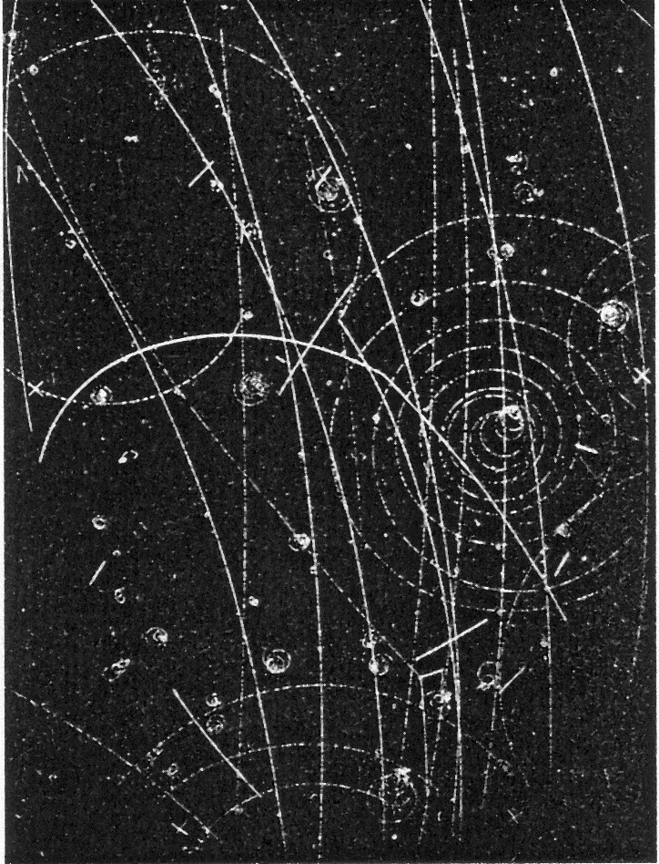
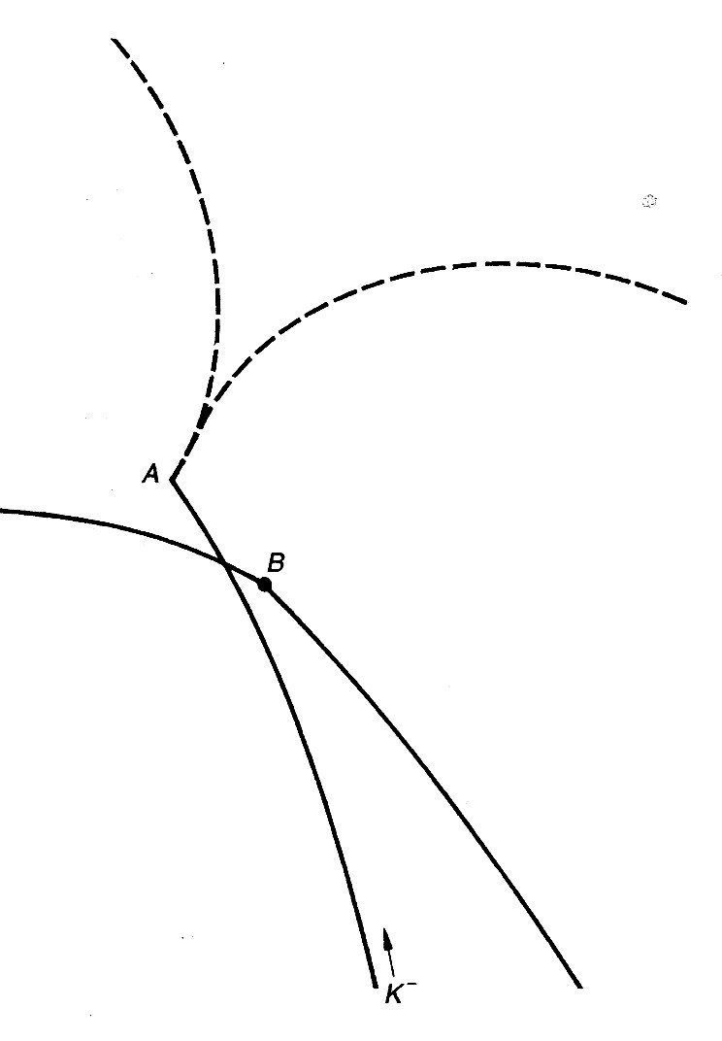
Strangeness
Conserved in strong interaction processes:
Not conserved in weak decays:
S = +1: K⁺, K° ; S = –1: Λ, Σ±, Σ° ; S = –2 : Ξ°, Ξ– ; S = 0 : all other particles
(and opposite strangeness –S for the corresponding antiparticles)
π° → e+ e– γ
(a rare decay)
Example of a K – stopping
in liquid hydrogen:
K – + p → Λ + π°
(strangeness conserving)
followed by the decay
Λ → p + π –
(strangeness violation)
π–
Λ is produced in A
and decays in B
p
K–

Slide 22
The Tau-Theta Puzzle
τ and θ were known to have the same mass and the same lifetime, but different decay modes!
τ decayed to 3π but θ into 2π
θ⁺ discovered 1953 (Menon and O’Ceallaigh)
In 1949, τ⁺➔π⁺π⁻π⁺ discovered using emulsions exposed to cosmic rays (Brown et. al.)
m ~ 500 MeV
In 1953 Dalitz showed that the 3π final state had spin parity of 0⁻, and the 2π state was known to have spin-parity 0⁺
Two pions (-1).(-1) = (+1)
Three pions (-1).(-1).(-1) = (-1)
So either they were different particles or parity was not conserved! (puzzle gets solved in 1957)

Slide 23
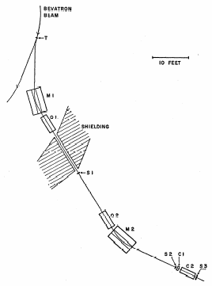
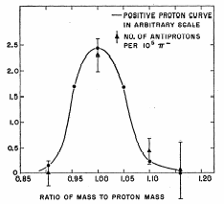
Antiproton discovery
Threshold energy for antiproton ( p ) production in proton – proton collisions
Baryon number conservation ⇒ simultaneous production of p and p (or p and n)
Example:
Threshold energy ~ 6 GeV
“Bevatron”: 6 GeV
proton synchrotron in Berkeley
build a beam line for 1.19 GeV/c momentum
select negatively charged particles (mostly π – )
reject fast π – by Čerenkov effect: light emission
in transparent medium if particle velocity v > c / n
(n: refraction index) – antiprotons have v < c / n
⇒ no Čerenkov light
measure time of flight between counters S₁ and S₂
(12 m path): 40 ns for π – , 51 ns for antiprotons
For fixed momentum,
time of flight gives
particle velocity, hence
particle mass

Slide 24
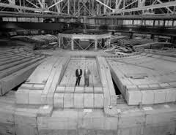
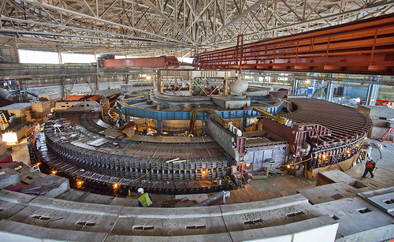
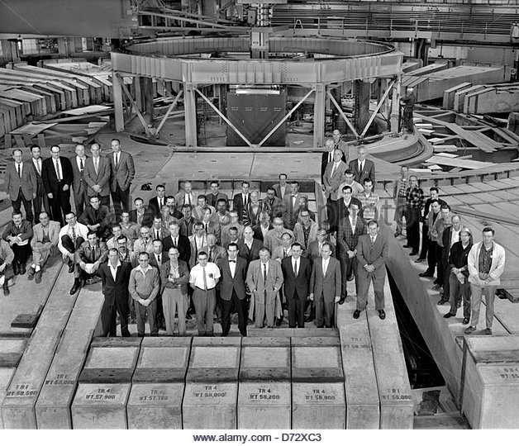

Bevatron
Click here for story on demolishing the Bevatron

Slide 25
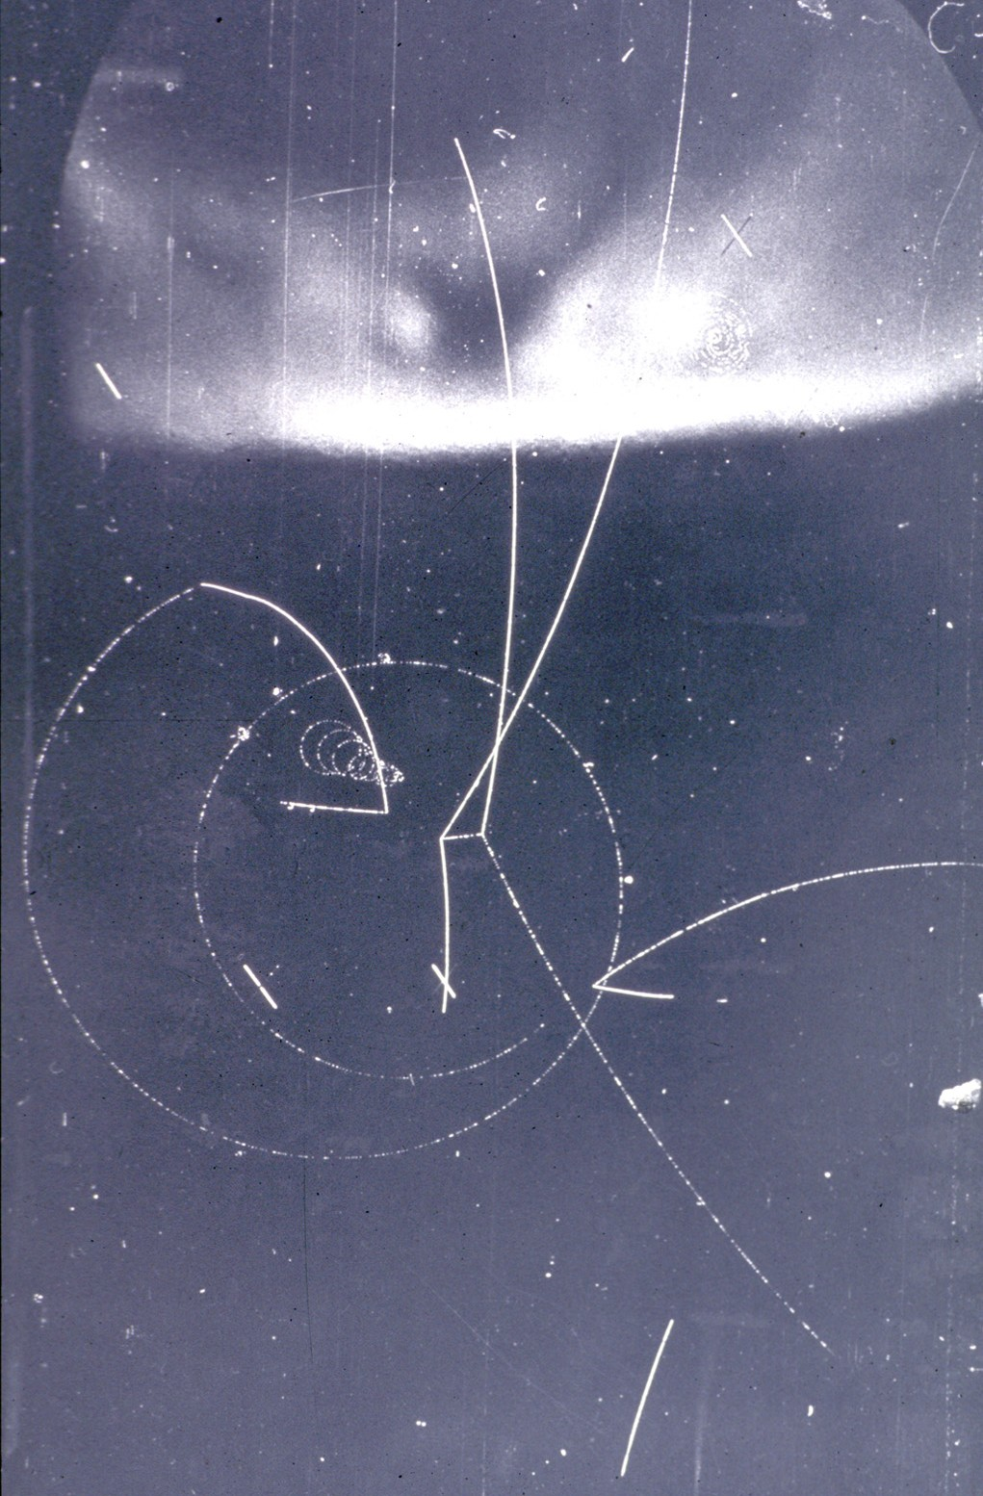
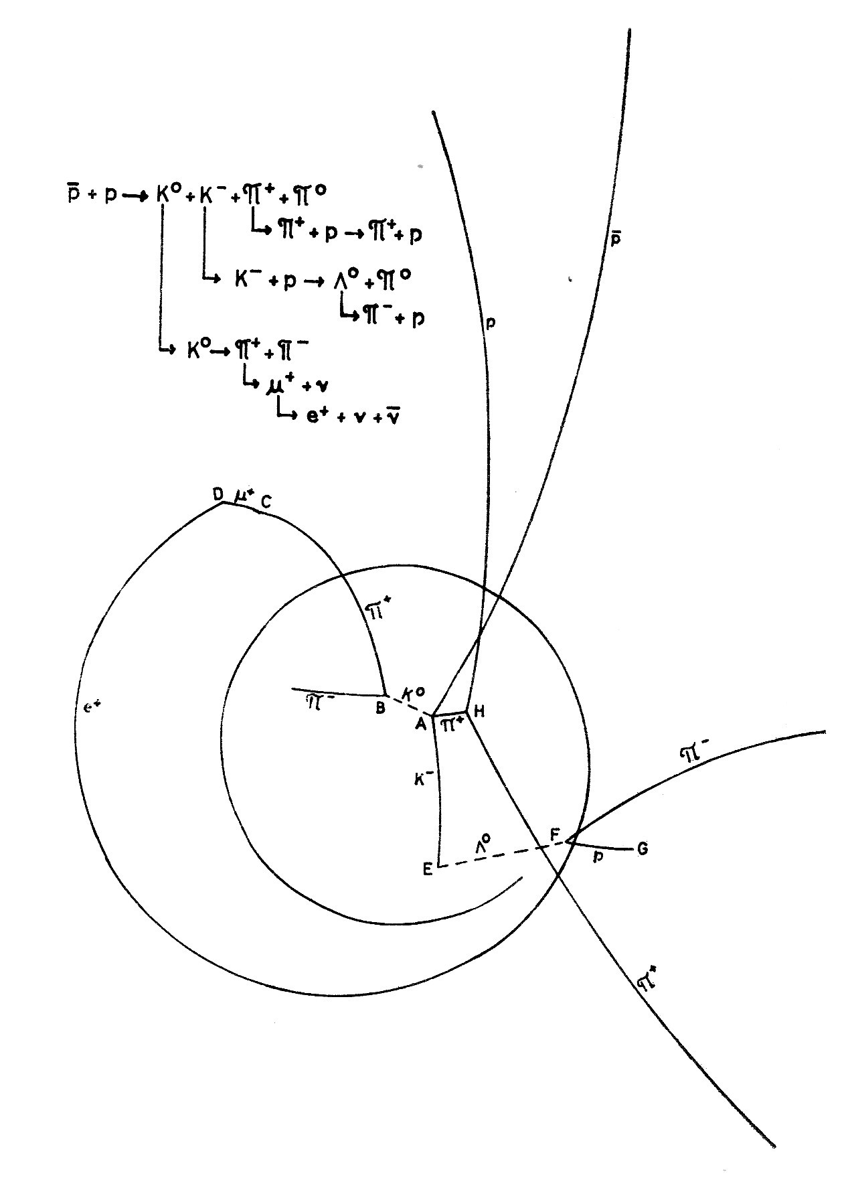
Example of antiproton annihilation at rest in a liquid hydrogen bubble chamber

